Slide 1
Welcome to ms. Geller’s class!
Monday, August 4, 2014
Pebblebrook high school

Slide 2
Warm-up: a note of introduction
Dear Ms. Geller,
My name is ____________. I am originally from __________________, but I have also lived in ________________ and __________________. The last two schools I attended were ______________ and _______________. My favorite subjects in school are _______________ and ________________. When I am not in school, I enjoy____________________. People tell me I am _______________. Another thing I would like you to know about me is __________________. In Literature this year, I hope to learn about _____________________.
Sincerely,
Your Full Name

Slide 3
Essential question: what do I need to know in order to be successful in ms. Geller’s class?
Seating Chart
Getting up, talking, moving around, etc.; “Give Me Five”
Practice: Pair-Share intro notes
Make-Up Binder
My Blog: GELLERESOL.WEEBLY.COM
Turning stuff in
Hall Passes/Tardies
Beginning and End of Class
At the beginning of class, there will ALWAYS be a warm-up activity on the board. These will be kept in your binder and checked every other week.
Please remain in your seat until you are dismissed at the end of class.
Technology: School policy—devices out of sight and silent unless we’re using them for something

Slide 4
supplies
Three-ring binder with dividers
Loose leaf notebook paper
Blue or black pens, plus another color for revision and editing
Flash drive
Highlighters
White-out
Art supplies (markers, glue stick, etc.)

Slide 5
Respect

Slide 6
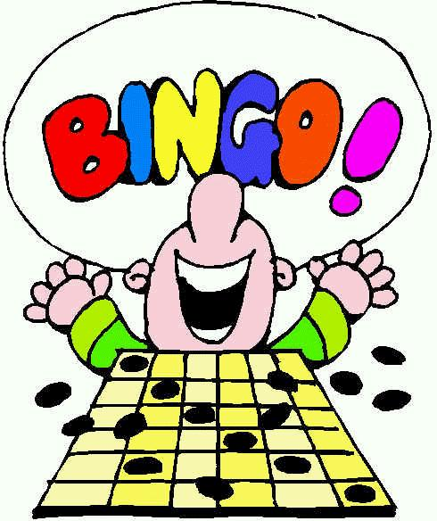
People bingo
Look for people who match the descriptions on the Bingo card.
Have the person write his or her name in the appropriate box; for example, if Tania likes broccoli, she will write “Tania” in the box under the N on your Bingo card.
You may not get the same person’s signature more than once.
The first three people to get a “BINGO” (five in a row—up, down, or diagonal) will win a prize.

Slide 7
Ticket out the door: how many ways are we smart?
Fold the paper vertically on the dark line so that the columns with the eight “multiple intelligences” (Nature Smart, etc.) are hidden.
Read each statement under “Which of the following are true about you?”
Place a check mark next to each item that is true about you.
Unfold the paper, and circle the X in each row that you checked.
Write the total number in each column at the bottom of the paper.
Choose the one or two categories that you had the highest score in.
Write your name next to these categories on the board.

