Slide 1
Media Mondays
Each student will be responsible for bringing in a current events article or video to discuss with the class.
You will be responsible for asking 3 higher-order thinking questions for the class to discuss.
Your classmates’ warm-up will be to write a response to the article.
How to submit your Media Monday:
Create a 1-slide PowerPoint presentation
Include an excerpt from the article or a link to a video (5 minutes or less) and your three questions
What is a H.O.T. Question?
Text-dependent but inferential
Cannot be answered with a simple yes/no, a number, or a single word
Require critical thinking; may have more than one correct answer

Slide 2
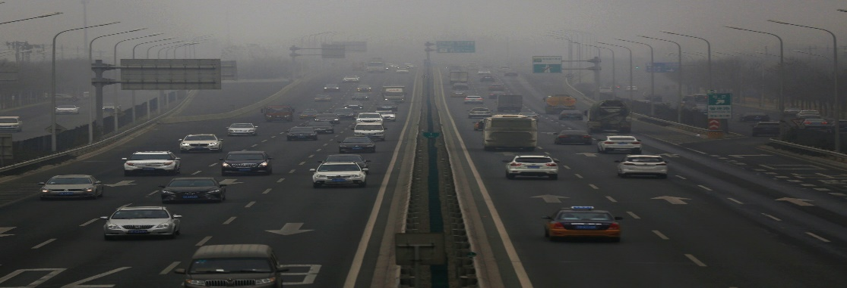
Media Monday Example
Greenhouse gas emissions worldwide are growing at an accelerating pace this year, researchers said Wednesday, putting the world on track to face some of the most severe consequences of global warming sooner than expected.
Scientists described the quickening rate of carbon dioxide emissions in stark terms, comparing it to a “speeding freight train” and laying part of the blame on an unexpected surge in the appetite for oil as people around the world not only buy more cars but also drive them farther than in the past — more than offsetting any gains from the spread of electric vehicles. (NY Times)
What is causing the increase in greenhouse gas emissions worldwide?
How much do you know about the “most severe consequences of global warming”?
How will this information impact your day-to-day life and the choices you make in the future?

