Slide 1
Tuesday, October 14, 2014
World Literature Warm-Up:
Fill in the blanks:
________________Yousafzai is a _______ year old advocate for the ________________ of women and ___________________to get an ___________. She just won the ________________Peace Prize.
Word Bank: NOBEL, RIGHTS, GIRLS, EDUCATION, SEVENTEEN, MALALA

Slide 2
World Lit Agenda for Today
Warm-Up
Malala on the Daily Show
Read/annotate Ch. 8
Work on project

Slide 3
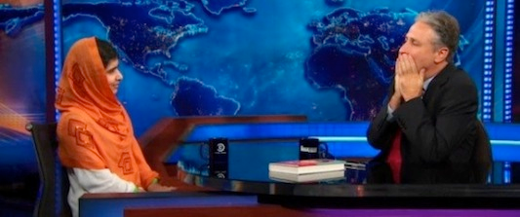
Malala’s Daily Show Interview
Take a minimum of 10 notes
Reflect: Other than their Muslim faith, what do Amal and Malala have in common in terms of their values? On the other hand, why are these girls’ day-to-day lives and concerns so very different?
Malala renders Jon Stewart speechless with her answer to the question, “What would you say to your intended Taliban killer?” What does she say? What would you say?

Slide 4
Tuesday, October 14, 2014
American Lit Warm-Up
Use the correct simple past tense form of the irregular verbs to complete each sentence.
Example: When I was little, I (think) Santa Claus was real. Thought
I can’t believe that lady (bring) her toddler to the club! ______________________
My Uncle Ed (teach) me how to read when I was three years old. _______________________
Lila struggled as a student, but she always (seek) help when she needed it. _____________________
I (buy) several cases of soda for the party.

Slide 5
Warm-Up Answers
I can’t believe that lady brought her toddler to the club!
My Uncle Ed taught me how to read when I was three years old.
Lila struggled as a student, but she always sought help when she needed it.
I bought several cases of soda for the party.

Slide 6
Dr. Martin Luther King, Jr.: “A Letter from Birmingham Jail”
April 1963: The Birmingham Campaign against segregation:
Sit-ins at restaurants, libraries, and other public places
Boycotts of segregated businesses
Nonviolent marches/protests
Mass voter registration drives
On April 10, the city of Birmingham passed a law against mass public demonstrations
King: ‘‘We cannot in all good conscience obey such an injunction which is an unjust, undemocratic and unconstitutional misuse of the legal process’’
A group of clergy leaders criticized King for disobeying the law; they said the issues of racial injustice should be handled through the courts
He wrote his “Letter from Birmingham Jail” while in solitary confinement

Slide 7
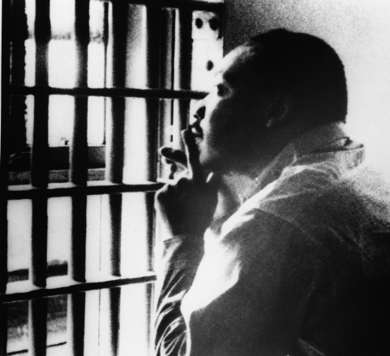
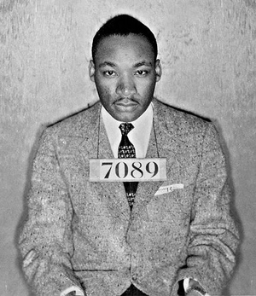
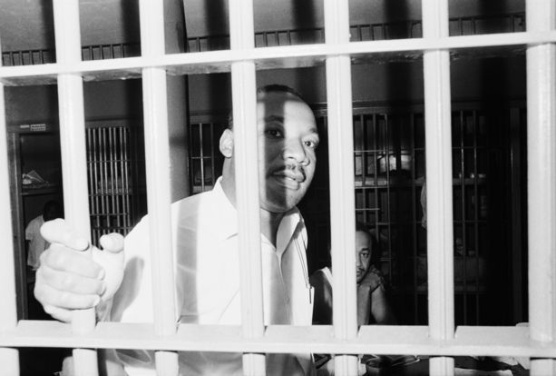
“Letter from a Birmingham Jail” Annotations: What to Look For
Label the following as they appear in the letter:
Ethos
Pathos
Logos
Counterarguments
Allusions
Call to Action
Metaphors
Rhetorical Questions
Parallel Structure
Unfamiliar Words
Connections to:
Transcendentalism
Unit theme of Individualism
Current events/issues

Slide 8
Rhetorical Strategies
Ethos: Appeal to ethics/authority/writer’s credibility
Pathos: Appeal to emotion
Logos: Appeal to logic/reason
Counterarguments: Addressing the opposing viewpoint
Allusions: References to well-known people, places, or things from literature, history, mythology, etc.
Call to Action: What should the audience DO?
Metaphors
Rhetorical Questions: Questions that are not supposed to be answered; used to make a point
Parallel Structure: Repetition of grammatical structures for rhythmic effect

Slide 9
World Lit Summarizer
What do you think Amal would think about Malala?
What would Malala say to Amal?
Which of these young ladies would you rather meet and why?

Slide 10
American Lit Summarizer
Although Thoreau influenced both Chris McCandless and Martin Luther King, Dr. King would most likely NOT approve of McCandless’s lifestyle. Why?

