Slide 1
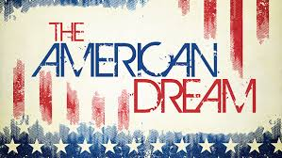
Wednesday, October 7, 2015
American Lit Warm-Up:
Part I: What does “the American Dream” mean to you?

Slide 2
American Lit Warm-Up Part II
Watch the “Crash Course” video on the Roaring Twenties, narrated by John Green (author of The Fault in Our Stars) and write down 5 things you learned about the time period.

Slide 3
American Lit Agenda for Today: The Roaring Twenties
Prezi or PowerPoint Presentation
Woman Suffrage Movement
Automobiles of the 1920s
The Harlem Renaissance
Movies of the 1920s
Sacco and Vanzetti
The Ku Klux Klan in the 1920s
Consumer Culture in the 1920s
Dancing in the 1920s
The Great Migration
The Stock Market Crash
Topics (no two students may use the same topic):
Prohibition
The Birth of Jazz
Al Capone
The Scopes Trial
Charlie Chaplin
Babe Ruth
Walt Disney
Amelia Earhart
Flappers

Slide 4
Sources to Use (NO WIKIPEDIA)
The History Channel:
http://www.history.com/topics/roaring-twenties
Online Textbook:
https://www.boundless.com/definition/the-jazz-age/
Digital History:
http://www.digitalhistory.uh.edu/era.cfm?eraID=13&smtID=1
Shmoop:
http://www.shmoop.com/1920s/summary.html

Slide 5
Summarizer
What do you need to do in order to be ready for tomorrow’s Socratic Seminar?

