Slide 1
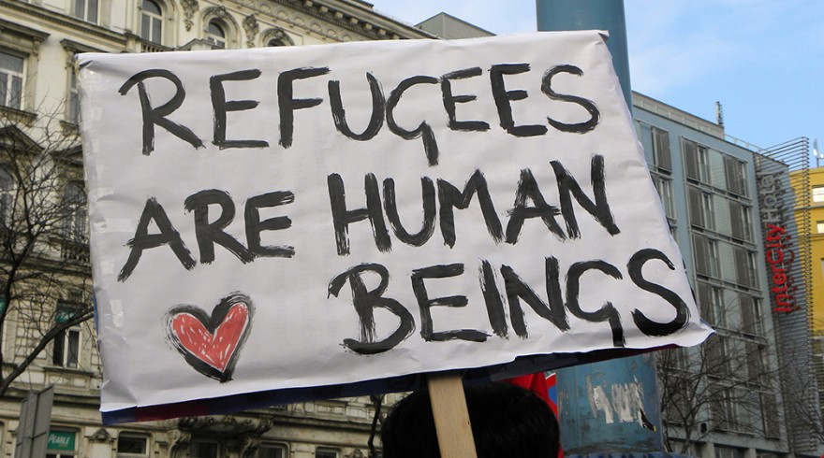
Welcoming Syrian Refugees
Susie Q. Student
American Literature -2nd Block
October 4th, 2016

Slide 2
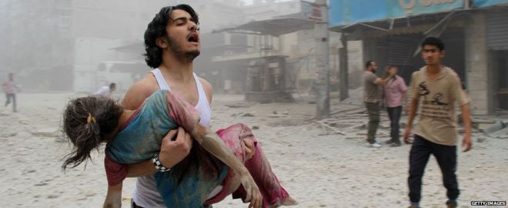
Introduction
Syria’s civil war began five years ago
250,000 dead; over 11 million displaced
President Bashar al-Assad vs. Rebels vs. ISIS

Slide 3

Why Should We Help?
The U.S. has the space and resources to help
We have contributed to the conflict
We should act according to our values
Refugees are not terrorists

Slide 4
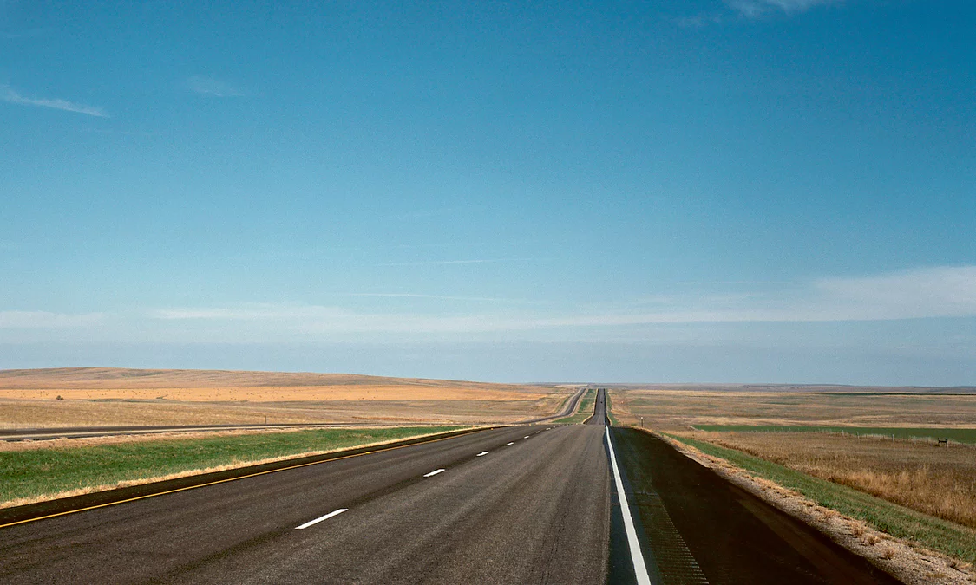
The U.S. Has Room and Resources
The U.S. is wealthy and powerful
Land area is 3.79 million square miles
Much less crowded than other countries that are accepting refugees

Slide 5
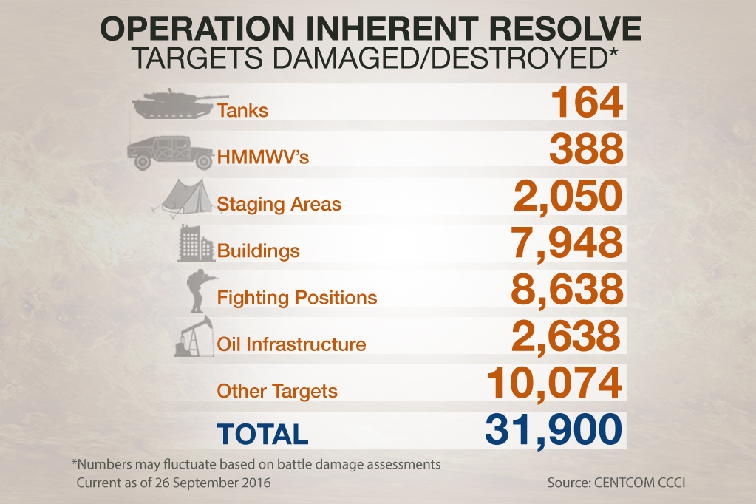
We Have Contributed to the Conflict
U.S. and its allies support the rebels
Hundreds of airstrikes, some killing civilians
Does dropping bombs keep anyone safe from terrorism?

Slide 6
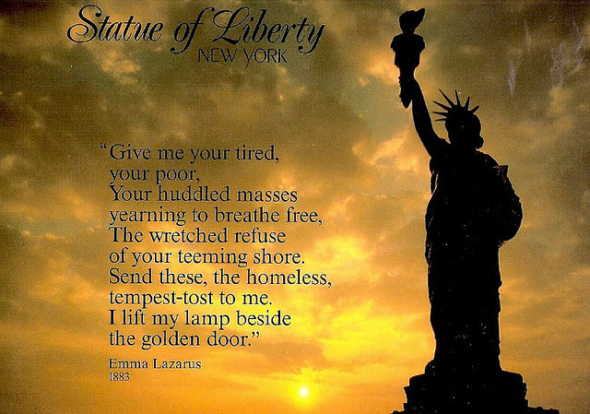
We Should Act According To Our Values
We are a nation of immigrants
We have a long history of helping those in need
Turning people away because of their race or religion is un-American

Slide 7
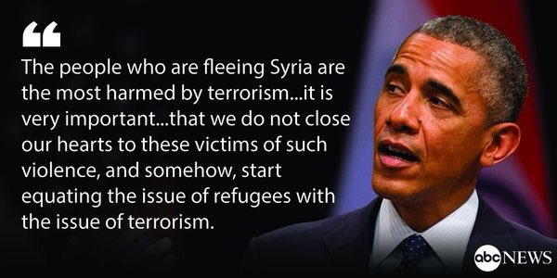
Refugees Are Not Terrorists
We have a strict screening process
None of the recent terror attacks in Europe have been linked to refugees
Many of those fleeing are women, children, and the elderly

Slide 8
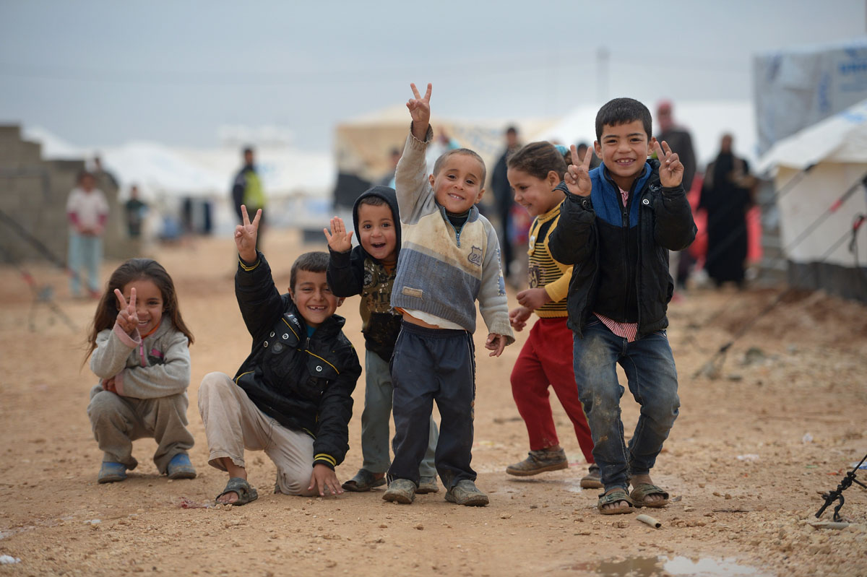
Call to Action
Contact your elected officials
Spread the word on social media
Choose candidates who support accepting refugees
Donate or volunteer with UNHCR, UNICEF, Mercy Corps, and other organizations that help refugees

Slide 9
Works Cited
Fallows, James. "Martin O’Malley Is Right: America Should Be Taking More Syrian Refugees." The Atlantic. Atlantic Media Company, 7 Sept. 2015. Web. 04 Oct. 2016.
Rogers, Lucy. "Syria: The Story of the Conflict." BBC News. N.p., 11 Mar. 2016. Web. 04 Oct. 2016.

